Slide 1
Research Progress Report Adaptive Token Fusion Transformer for Multi-Modal Object Detection with RGB and Event Data
羅偉明 La Vi Minh
NTUST HIS-LAB
Date: 2025-08-31

Slide 2
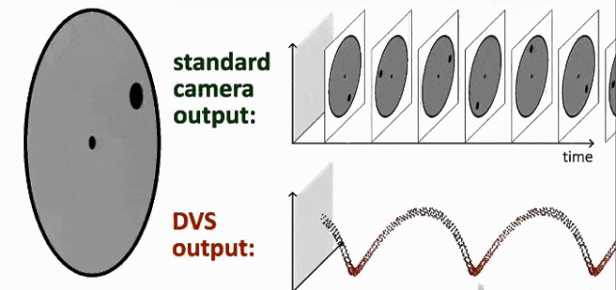
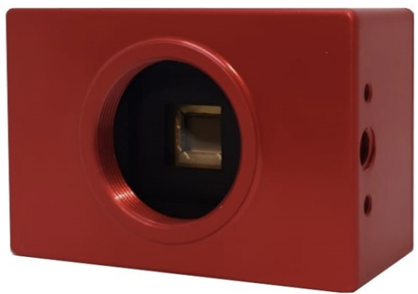
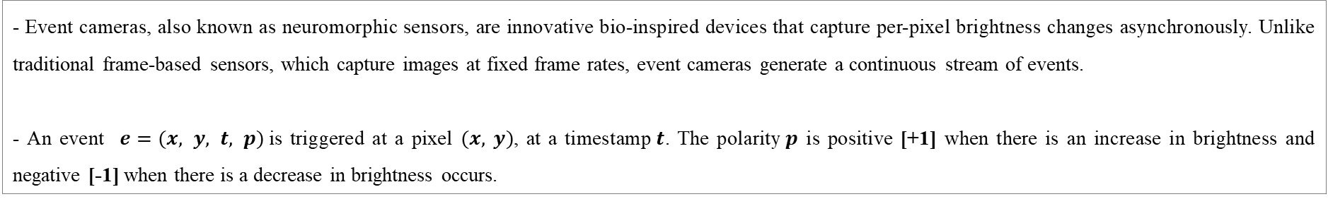
Introduction
- Event cameras, also known as neuromorphic sensors, are innovative bio-inspired devices that capture per-pixel brightness changes asynchronously. Unlike traditional frame-based sensors, which capture images at fixed frame rates, event cameras generate a continuous stream of events.
- An event $e=(x, y, t, p)$is triggered at a pixel $(x,$ $y)$, at a timestamp$t$. The polarity$p$ is positive [+1] when there is an increase in brightness and negative [-1] when there is a decrease in brightness occurs.
Fig. 1. Simulation of event camera operating principle
Fig. 2. DAVIS 346 event camera
2

Slide 3
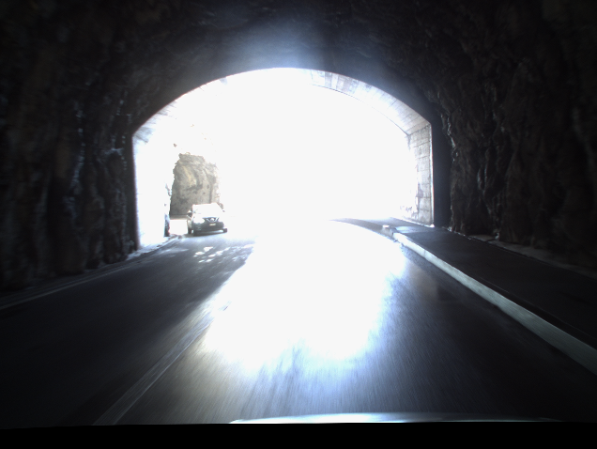
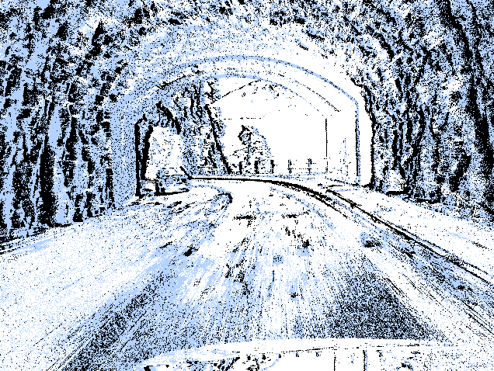
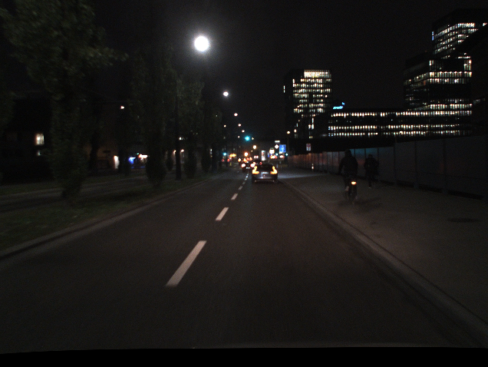
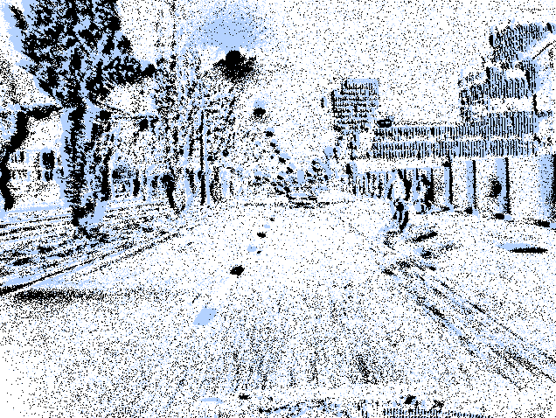
Introduction
- Event sensors provide several advantages over conventional cameras, including microsecond-level temporal resolution, an exceptionally high dynamic range (140 dB vs. 60 dB), and low power consumption. Their ability to quickly respond to sudden changes, adapt to diverse weather and lighting conditions, and capture high-speed visual information has made them increasingly valuable in autonomous vehicles.
- Fusing event sensors with RGB cameras enables more robust and accurate object detection by combining the high temporal resolution and dynamic range of event sensors with the rich texture and color information from RGB cameras.
RGB camera
Event camera
RGB camera
Event camera
Fig. 3. Driving in high-exposure conditions
Fig. 4. Driving in poor lighting conditions
3

Slide 4
Related Works
Model | Pub. & Year | Backbone | Dataset | Highlights
FPN Fusion [1] | ICRA’ 2022 | CNN | DSEC-Det | A sensor fusion approach for robust object detection using RetinaNet’s feature pyramidal network, improving performance under image corruption.
RENet [2] | ICRA’ 2023 | CNN | DSEC-MOD | A fusion network for moving object detection feature multi-scale event aggregation and coarse-to-fine feature fusion with attention-based cross-calibration.
EOLO [3] | ICRA’ 2024 | CNN + SNN | PASCAL VOC MS COCO | A fusion network for all-day object detection using RGB and event data, featuring a spiking neural network, temporal attention for event refinement, and a symmetric RGB-Event fusion module for balanced cross-modal alignment.
CAFR [4] | ECCV’ 2024 | CNN | DSEC-Det PKU-DDD17-Car | A hierarchical fusion network using the CAFR module, which enhances event features through attention and feature statistics in a coarse-to-fine manner.
Fradi et al. [5] | IRC’ 2024 | CNN | DSEC-MOD | A very-late fusion approach with detector ensembling on RGB-Event data, using probabilistic ensembling based on Bayes' rule for improved performance.
Sin-Ye et al. [6] | ICRA’ 2025 | CNN + RNN | DSEC-Det | A Hierarchical Spatiotemporal Fusion method for object detection, using GEAR and TFS modules to improve temporal feature fusion and accuracy under complex lighting.
Fig. 5. Related Works of RGB-Event Fusion for Object Detection
4

Slide 5
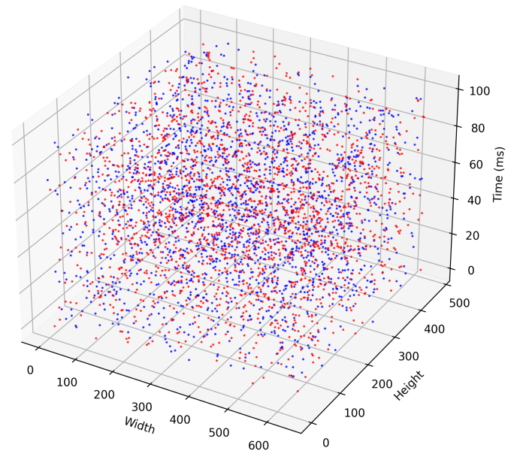
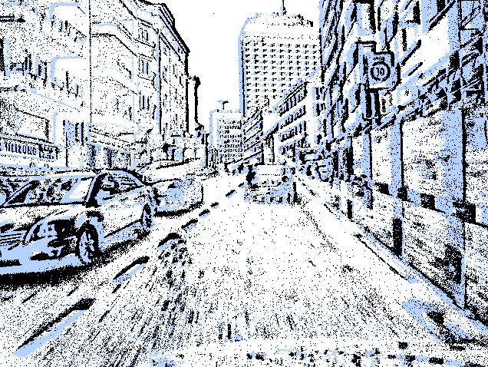
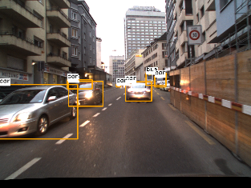
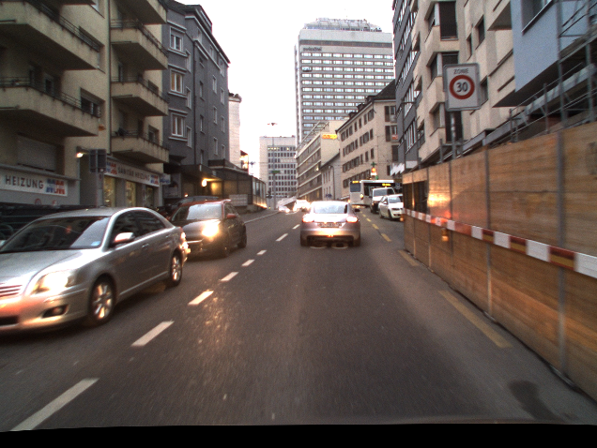
Object Detection RGB-Event Fusion Network
H/8×W/8×512
H/16×W/16×512
H/32×W/32×512
P3
Detection
PANet and Head
P4
F.Block_{E1}
F.Block_{E2}
F.Block_{E3}
F.Block_{E4}
F.Block_{E5}
P5
Event asynchronous data
P3
P4
P5
Event frame input
ATFT
ATFT
ATFT
ToggleEV Event Representation
F.Block_{R1}
F.Block_{R2}
F.Block_{R3}
F.Block_{R4}
F.Block_{R5}
Final detections
RGB input
H/8×W/8×512
H/16×W/16×512
H/32×W/32×512
: element wise addition
Fig. 6: Overview of the proposed ATFT network architecture. Built upon a YOLOv11-based dual-stream design, the network first converts raw event streams into structured event frames using the ToggleEV representation. Its backbone comprises parallel feature extractors for RGB and event data, along with ATFT modules that operate across multiple scales, enabling effective integration of tokenized features with a two-stage attention mechanism.
5

Slide 6
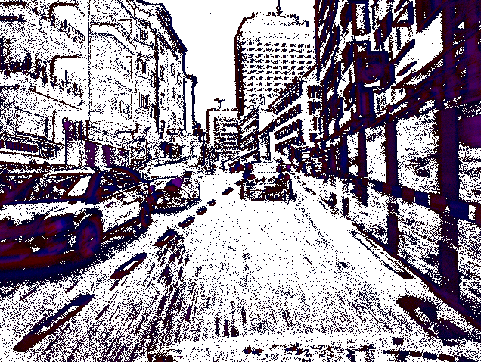
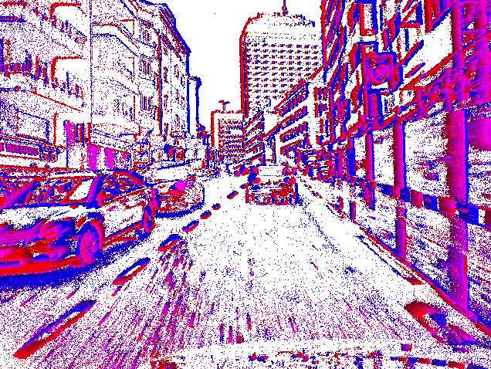
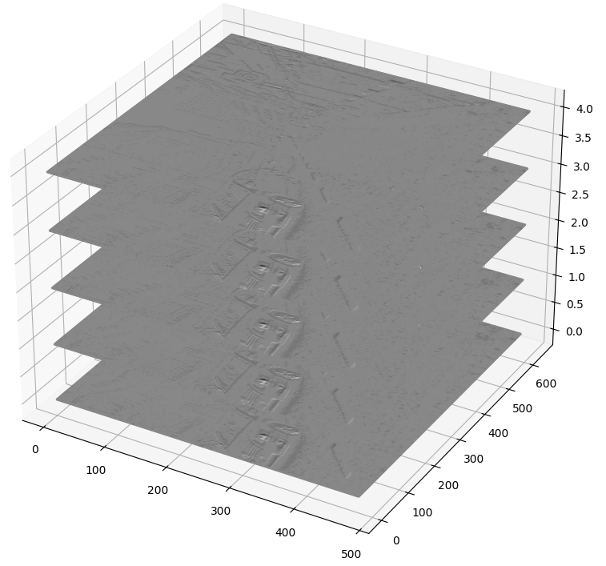
Event Representation
Event representations involve converting asynchronous event data into a structured and interpretable format, typically a 2D dense grid, making it compatible as input for conventional deep neural networks or other machine learning models. Several event representations have been proposed. The following are some approaches commonly used for object detection and classification tasks:
Two-Channel Image: create a 2D grid where each pixel represents the event accumulation based on polarity (positive or negative intensity changes) within the time window [7].
Time Surface: encode the temporal dynamics of events, highlighting recent activity while reducing the influence of older events [8].
Voxel Grid: represent the 3D space divided into small volumetric units (voxels), where event data is accumulated over time bins. This method captures both spatial and temporal dynamics, enabling detailed modeling of motion and interactions [10].
Two-Channel Image [7]
Time Surface [8]
Voxel Grid [9]
6

Slide 7
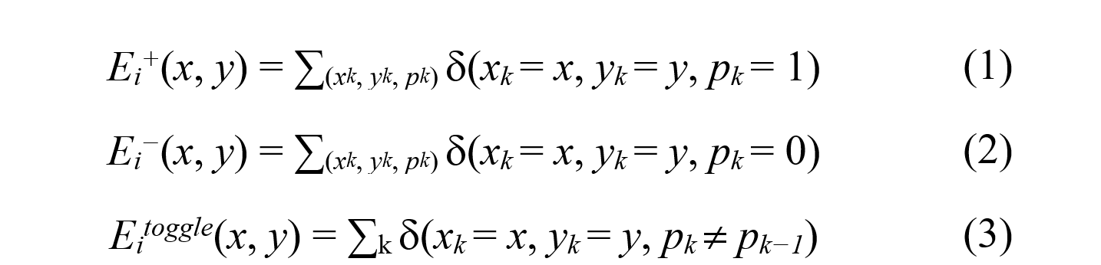
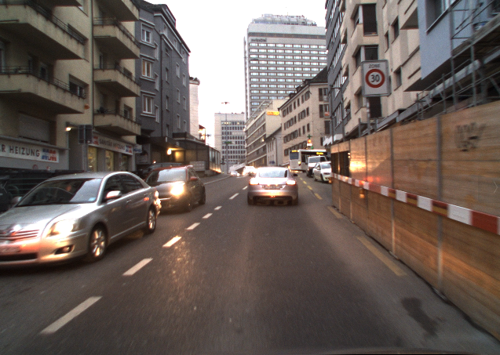
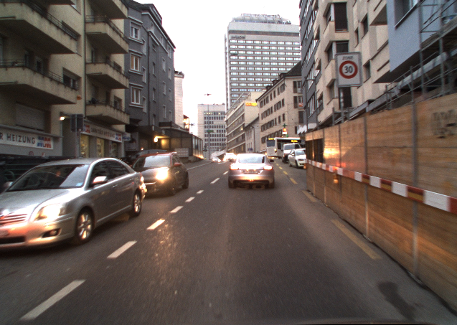
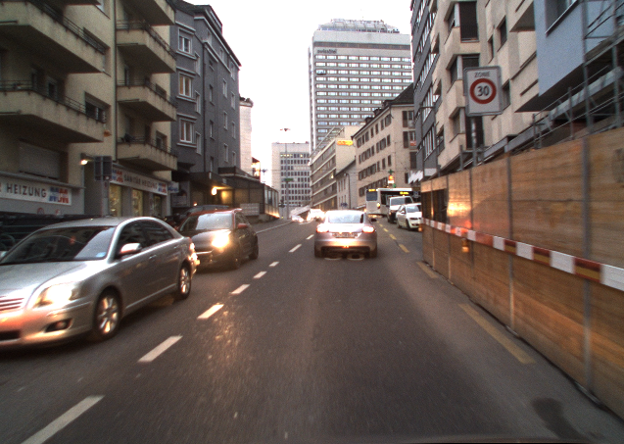
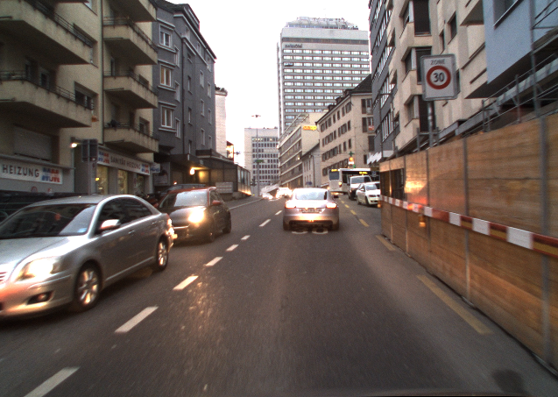
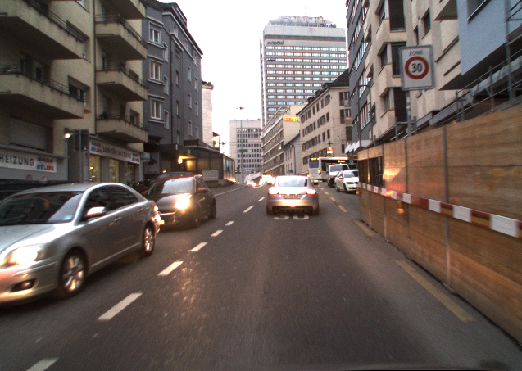
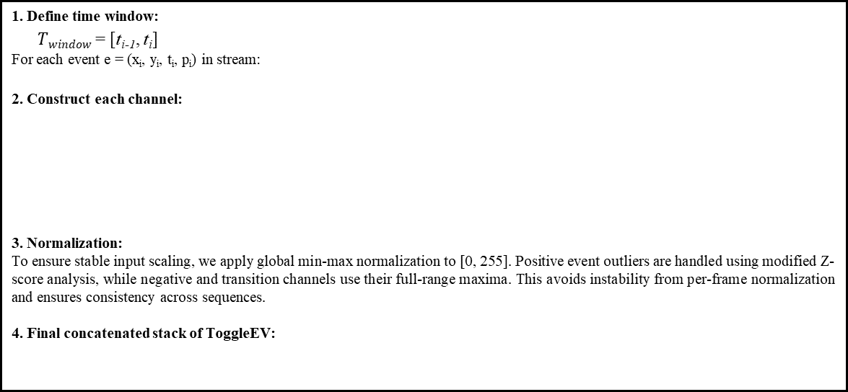
ToggleEV Event Representation
Transforms the raw asynchronous event stream into a structured three-dimensional frame stack by temporally aggregating events into fixed intervals and encoding them across three channels: positive events, negative events, and a polarity transition map. This representation preserves fine-grained spatial information while capturing the temporal dynamics of scene motion, resulting in a compact and informative input compatible with standard vision architectures.
ToggleEV Event Representation
Implementation of ToggleEV Event Representation
1. Define time window:
$Twindow$ = [t_{i-1}, t_{i}]
For each event e = (x_{i}, y_{i}, t_{i}, p_{i}) in stream:
2. Construct each channel:
3. Normalization:
To ensure stable input scaling, we apply global min-max normalization to [0, 255]. Positive event outliers are handled using modified Z-score analysis, while negative and transition channels use their full-range maxima. This avoids instability from per-frame normalization and ensures consistency across sequences.
4. Final concatenated stack of ToggleEV:
Event asynchronous data
Event frame input
* For visualization purpose only
time
time window
7

Slide 8
Adaptive Tokenization Fusion Transformer (ATFT)
Adaptive Tokenization Fusion Transformer module introduces a two-stage attention mechanism that integrates channel attention with multi-head self-attention to enable robust, context-aware feature fusion. This design enhances both intra-modal and cross-modal integration by explicitly modeling token-level dependencies and adaptively recalibrating channel-wise feature importance based on modality-specific cues.
Token S.’
F_{E}
F’_{E}
MLP
Layer Norm
Sigmoid
Channel Attention
FC layer 2
F’_{R}
ReLU
F_{R}
Multi-Head
Attention
FC layer 1
Layer Norm
AvgPool
Token S.
Positional Embedding
Fig. 7. ATFT Module
Fig. 8. Channel Attention Block
9

Slide 9
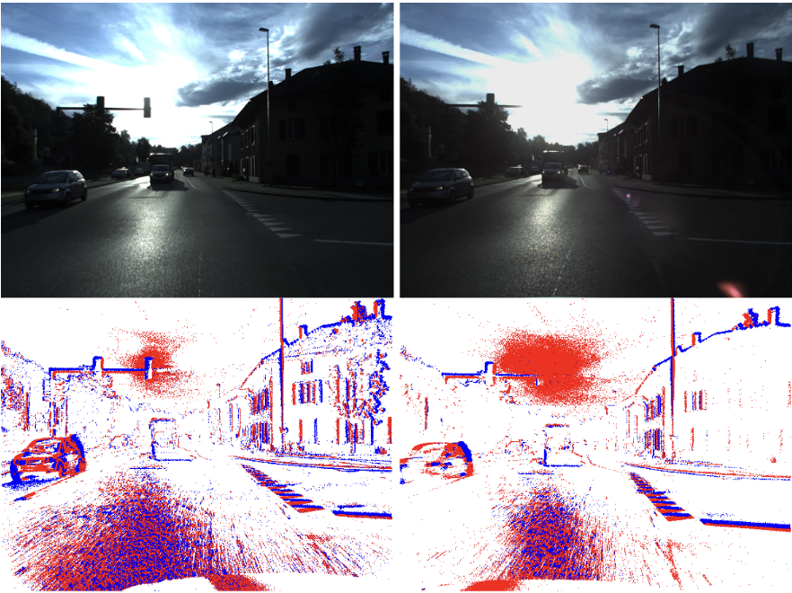
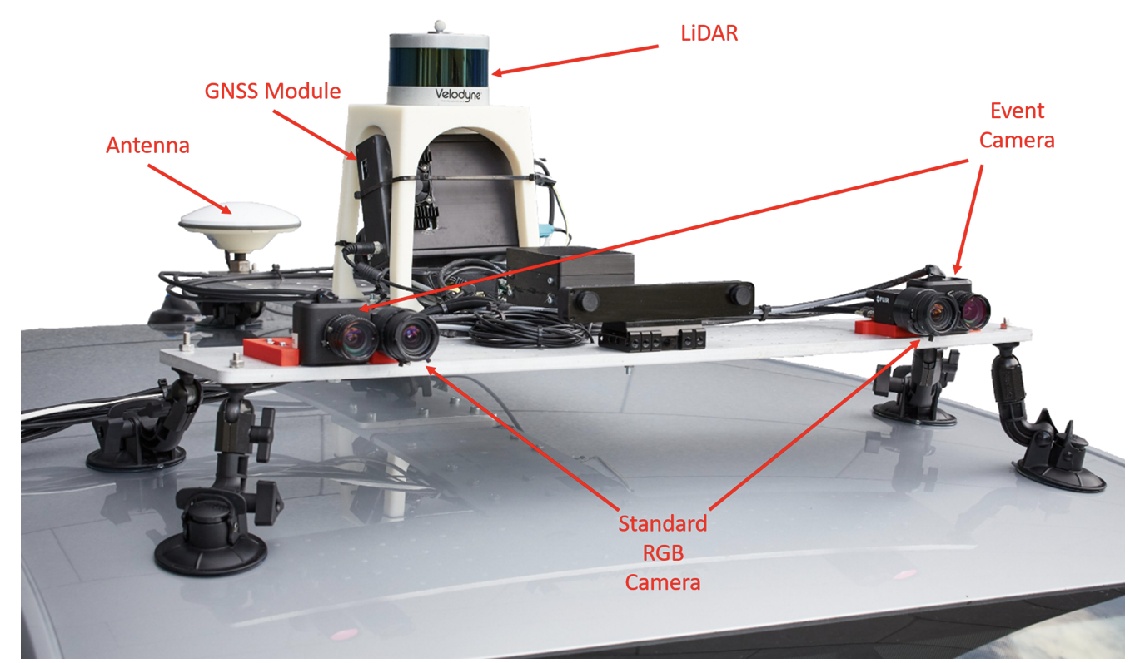
Dataset and Experiments Setting
DSEC-Detection dataset [10] extends the original DSEC collection [11] by providing high-quality bounding box annotations on sequences recorded using a multi-sensor driving platform equipped with Prophesee Gen3.1 event cameras and synchronized FLIR Blackfly S color cameras. It comprises 60 sequences in total, divided into 47 training sequences (63,239 frames) and 13 test sequences (15,105 frames).
The model is trained using the Stochastic Gradient Descent (SGD) optimizer with a learning rate of 0.01, momentum of 0.9, and a batch size of 16. To improve generalization, we apply a set of data augmentation techniques, including random scaling, translation, Mosaic composition, image resizing, and horizontal flipping. Training is performed for 30 epochs, with early stopping based on validation performance to prevent overfitting. All experiments are conducted on a NVIDIA RTX 3090 GPU.
Fig. 9. The sensor suite mounted on top of a car
Fig. 10. DSEC-Detection dataset
11

Slide 10
Benchmark Comparisons
Modality | Method | Input Representation | DSEC-Detection
 |  |  | mAP50 (%) | mAP50-95 (%) | Params (M)
Event | YOLOv11 | ToggleEV | 32.2 | 16.9 | 25.4
 | RT-DETR [13] | ToggleEV | 29.8 | 16.5 | 32.8
Frame | YOLOv11 |  | 75.0 | 54.2 | 25.4
 | RT-DETR [13] |  | 65.8 | 44.9 | 32.8
Fusion | RENet [2] | E-TMA | 42.6 | 24.0 | 66.2
 | EOLO [3] | Two-Channel Image | 46.6 | 28.6 | 46.3
 | CAFR [4] | Voxel Grid | 60.6 | 36.7 | 82.5
 | Sin-Ye et al. | GEAR | 67.8 | 45.9 | 24.1
 | ATFT (Ours) | Two-Channel Image [7] | 74.5 | 53.2 | 57.4
 |  | HOTS [8] | 74.7 | 53.4 | 57.4
 |  | Voxel Grid [9] | 75.6 | 54.6 | 57.4
 |  | GEAR | 72.7 | 51.1 | 57.4
 |  | ToggleEV (Ours) | 76.8 | 55.0 | 57.4
Fig. 9. Comparison with SOTA fusion alternatives
11

Slide 11
Ablation Study
The purpose of this study is to investigate how different fusion designs influence the network’s ability to integrate RGB and event features. First, we adopt a simple two-stream feature addition mechanism as the multiscale fusion module. Next, we replace this with the baseline CFT [15] fusion module. Finally, we substitute the fusion module with CMIT, a variant of CFT introduced by Shangpo et al. [16].
Fusion module | mAP50 (%) | mAP50-95 (%)
Two Stream Addition | 74.9 | 53.7
CFT [14] | 73.9 | 52.3
CMIT [15] | 75.9 | 54.3
ATFT (Ours) | 76.8 | 55.0
Fig. 10. Ablation Study on Fusion Modules
11

Slide 12
References
[1] Fusing Event-based and RGB camera for Robust Object Detection in Adverse Conditions, 2022
[2] RGB-Event Fusion for Moving Object Detection in Autonomous Driving, 2023
[3] Chasing Day and Night: Towards Robust and Efficient All-Day Object Detection Guided by an Event Camera, 2024
[4] Embracing Events and Frames with Hierarchical Feature Refinement Network for Object Detection, 2024
[5] Advancing Object Detection for Autonomous Vehicles via General Purpose Event-RGB Fusion, 2024
[6] Hierarchical Spatiotemporal Fusion for Event-Visible Object Detection, 2025
[7] Event-based Vision meets Deep Learning on Steering Prediction for Self-driving Cars, 2018
[8] Hots: a hierarchy of event-based time-surfaces for pattern recognition, 2017
[9] Unsupervised Learning of Dense Optical Flow, Depth and Egomotion with Event-Based Sensors, 2020
[10] Low-latency automotive vision with event cameras, 2024
[11] DSEC: A Stereo Event Camera Dataset for Driving Scenarios, 2021
[12] Recurrent Vision Transformers for Object Detection with Event Cameras, 2023
[13] DETRs Beat YOLOs on Real-time Object Detection, 2024
[14] Cross-Modality Fusion Transformer for Multispectral Object Detection, 2021
[15] MCAFNet: Multiscale cross-modality adaptive fusion network for multispectral object detection, 2025
13

Slide 13
Thank you for your attention

Slide 14
H/8×W/8×512
H/16×W/16×512
H/32×W/32×512
P3
Detection
PANet and Head
P4
F.Block_{E1}
F.Block_{E2}
F.Block_{E3}
F.Block_{E4}
F.Block_{E5}
P5
Event asynchronous data
P3
P4
P5
Event frame input
ATFT
ATFT
ATFT
ToggleEV Event Representation
F.Block_{R1}
F.Block_{R2}
F.Block_{R3}
F.Block_{R4}
F.Block_{R5}
Final detections
RGB input
H/8×W/8×512
H/16×W/16×512
H/32×W/32×512
: element wise addition
Token S.’
F_{E}
F’_{E}
MLP
Layer Norm
Sigmoid
Channel Attention
FC layer 2
F’_{R}
ReLU
F_{R}
Multi-Head
Attention
FC layer 1
Layer Norm
AvgPool
Token S.
Positional Embedding
(a) ATFT Module
(b) Channel Attention Block

Slide 15
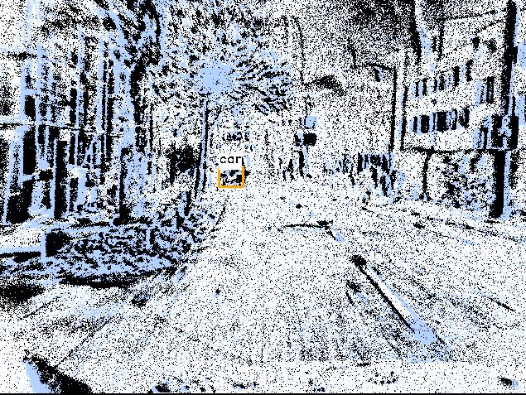
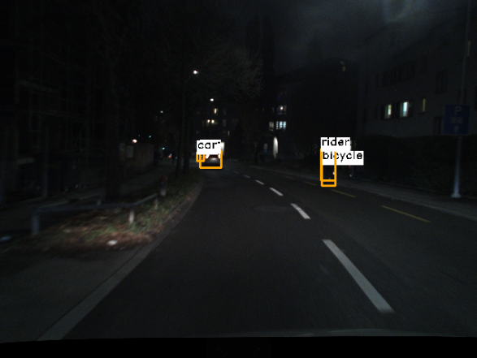
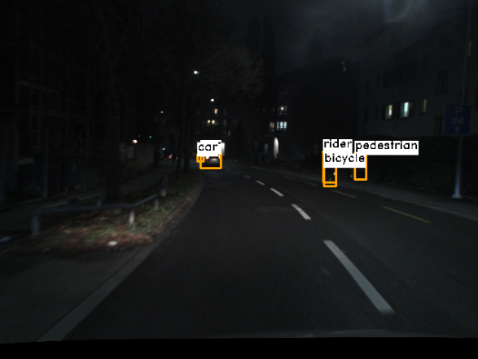
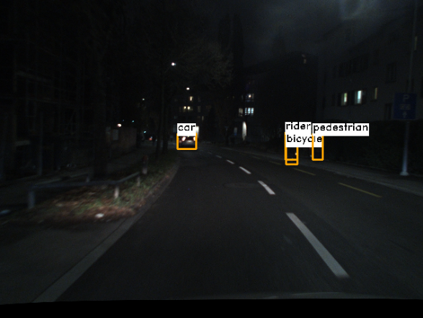
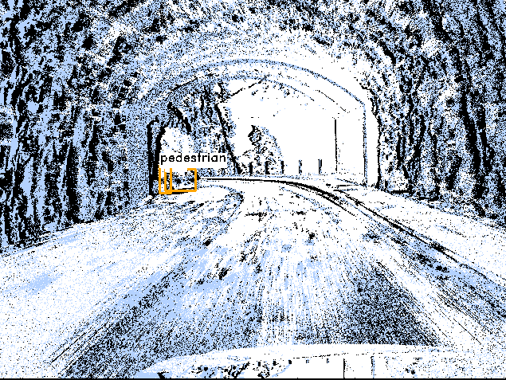
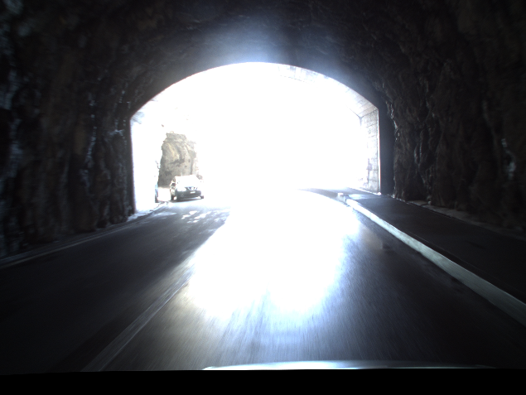
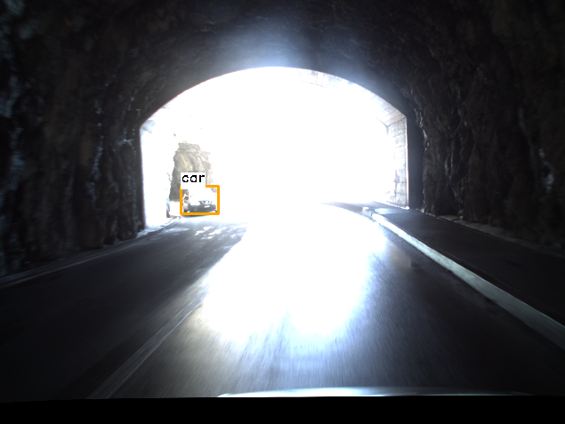
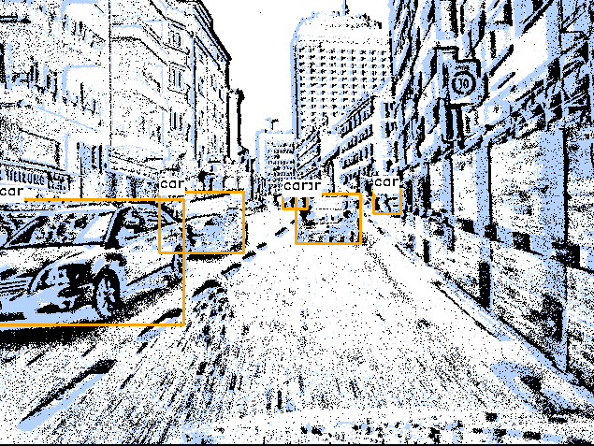

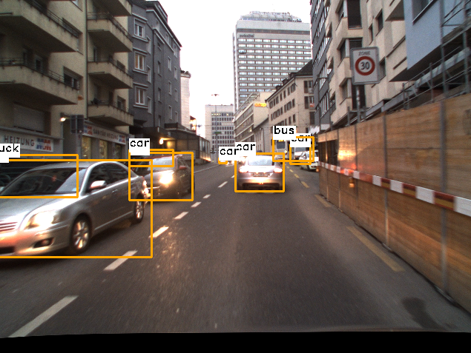

(a) YOLOv11 (Event)
(b) YOLOv11 (RGB)
(c) Ground Truth
(d) ATFT (Fusion)

